Slide 1
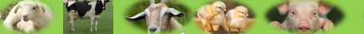
Beef Production and Management
Michael Luwe
Department of Animal Health and Livestock Development

Slide 2
Beef Production and Management
Introduction
All domestic cattle whether for milk, beef or both belong to the family Bovidae of the genus Bos.
Worldwide there are more than 250 breeds of beef cattle. Over 60 of these breeds are present in the United States.
Based on climate, cattle can be grouped into two:
Bos taurus (Temperate breeds): Comfort zone 4 – 15ºC e.g. Angus, Hereford, Charolais
Bos indicus (Tropical breeds): Comfort zone 15 – 35ºC e.g. Malawi Zebu, Brahman

Slide 3
Notable Differences between Bos taurus and Bos indicus
Bos taurus | Bos indicus
No hump | Hump present on the neck or chest
Skin relatively thick (7 – 8mm) and held tightly to body | Skin relatively thin (5 – 6mm) and very loose often falling away from body in folds.
Fast maturing (Full mouth in 4 years) | Slow maturing (Full mouth in 5½ years)
Hair relatively long | Hair relatively short
Rounded ear, held at right angles to the head | Pointed drooping ears
Large and reach over 1300kg in size. | Small and rarely reach 700kg

Slide 4
Advantages of Beef Animals
Food ~ source of animal protein
Income ~ selling live animal, fresh meat
Source of employment
Fulfilling social and cultural needs and obligations.
Nutrient recycling
Drought power
Cattle depends on forages as their main feed hence no competition for food with human beings

Slide 5
Constraints associated with Beef Production
The genetic potential of indigenous livestock in need of improvement;
The widespread distribution of livestock diseases;
Slaughter of breedable stock (heifers, pregnant cows).
Poor marketing infrastructure and arrangements;
Animal theft;
Poor management e.g. inbreeding.
Lack of good quality feed and grazing resources

Slide 6
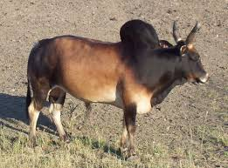
Beef breeds in Malawi
Malawi Zebu
``
Found in Malawi; similar to Angoni and Angone cattle of Zambia and Mozambique respectively.
Adapted to a wide range of conditions.
Colour is variable; red, brown, black, red or black and white or brindle exist.
Mature bulls weigh 650kg and cows weight 480kg.
Horns are short and thick and lateral rather than upright; hump and dewlap well developed.

Slide 7
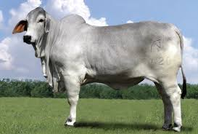
Beef breeds in Malawi
Brahman
Beef breed; originally from India but developed in America.
Good mothering ability and excellent ability to forage on poor range.
Colour varies from light grey, red to almost black.
Mature bulls weigh 980kg and cows weight 680kg.
It has a large hump, pendulous ears, large dewlap and long legs.

Slide 8
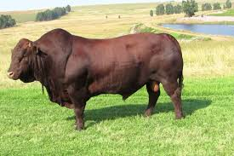
Beef breeds in Malawi
Bonsmara
Beef breed originally from South Africa.
Deep red or brown coat.
Low birth weights therefore easier calving.
Good mothering ability.
Mature bulls weigh 950kg and mature cows weight 618kg.

Slide 9
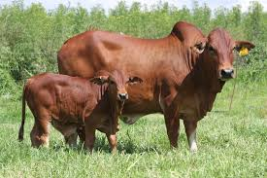
Beef breeds in Malawi
Boran
Beef breed originally from Ethiopia.
Variable coat colour; white, black red and fawn.
Hindquarters are well developed.
Mature bulls weigh 600 – 800kg and mature cows weight 450 – 600kg.
It has a large hump, large dewlap and folds of skin around the neck.

Slide 10
Beef Production Systems in Malawi
i. Extensive system
Using a large expanse of land – low input and low output system.
Commonly practised by subsistence farmers whose goal is not profit maximisation.
Ranching is also regarded as an extensive type of system .

Slide 11
Beef Production Systems in Malawi
ii. Fattening schemes
Feedlot system
Involves keeping a large number of animals
Practice cut and carry feeding system
By large scale farmers
Requires high management levels
Profit margin is reasonable

Slide 12
Beef Production Systems in Malawi
Stall feeding system
Animals kept in stall and fattened prior to slaughter.
Deals with a small number of animals
Involves cut and carry system
Movement is highly restricted
Mostly practiced by smallholder crop farmers
Off-Grass scheme
Animals are on improved pasture in paddocks

Slide 13
Systems can be:
Complete system
The animals are reared, bred and finished at the same place.
Split scheme
It has breeding and rearing done at one place and finishing at a different place.
It allows a certain degree of specialisation.

Slide 14
Reproduction
The gestation period of a cow is between 280 – 290 days depending on breed.
Oestrous behaviour lasts for approximately 14 hours immediately prior to ovulation in each 21-day cycle, and is longer in cows than heifers.
Cows can therefore be mated to calve at yearly intervals. Cows in poor condition and further stressed by lactation may stop cycling – lactation anoestrus.
Cows should not be served before 42 days postpartum, as conception rates are likely to be less than 40%, whereas they increase to 50% by 50 days postpartum.

Slide 15
Reproduction
Heifers should be served for the first time when they are about 2½ years old.
The best indicator is live weights. However, this will vary from breed to breed but the rule is to serve heifers when they are at two-thirds of the expected adult weight.
The ratio of bulls to cows is 1 to 25 – 30.
The ratio declines where animals travel long distances.
In Malawi, the appropriate time to breed animals is between December and March. This enables animals to mate when they have access to good quality fodder hence high conception rates. Calves are also weaned when there is adequate fodder around.

Slide 16
Managing the Cow Herd
Selection of Breeding Cows
Selecting the most suitable breeding stock will improve the herd and performance.
The following guiding principles should be followed:
Should have a well developed udder with four functional well developed teats; soft to touch and free from injury.
Good conformation (blocky and wide hip bones for ease calving).
Selected from a cow known from records to calve regularly.
Should have high growth rates.
Healthy and free from any deformities.

Slide 17
Selection of Bulls
Choose those with the following attributes:
Offsprings of a cow with good mothering ability
Should not be related directly or indirectly to any of the cows in the herd.
Should have high growth rate
Should have good conformation.
Healthy and free from deformities.
High libido

Slide 18
Methods of Mating
Hand mating
The bull is kept separately from the cows except when the cows comes on heat.
Artificial insemination is also considered to be a hand mating technique.
Common in dairy production.
Advantages
Avoids premature mating
Records can be kept properly.
Allows cows to recover from previous calving.
Disadvantages
Heat detection is difficult
Requires extra housing and feeding

Slide 19
Methods of Mating
Pasture mating
Two major systems used:
All year round / Continuous
Restricted/ Seasonal breeding
All Year Round/Continuous
Cow and heifers are allowed to run with the bulls throughout the year.
This results in calves dropped throughout the year.
Restricted/Seasonal breeding
Bulls are allowed to run with cows and heifers during a 3 months breeding period.
The cows are expected to calve down at the same period.

Slide 20
Breeding Objectives
Feed utilization efficiency
Feed is the major cost in most beef cattle production systems, comprising about 80% of the variable costs.
Therefore, improving the efficiency of beef cattle production is usually directed at reducing the feed conversion ratio.
Carcass traits
Possible carcass traits to select for include carcass weight, which has good heritability.
Within a breed, animals with a high ratio of muscle to other tissues at a certain stage of their development are likely to have increased value.

Slide 21
Breeding Objectives
Reproductive traits
An ability to survive and reproduce under poor feed conditions would be advantageous in many marginal regions, and is likely to favour small cattle with low maintenance requirements. However, reproductive traits are not easily improved.
Environment and welfare traits
Breeding cattle without horns will prevent a significant additional stress that dehorning creates.
Breeding for good temperament would be likely to increase growth rates.

Slide 22
Breeding Objectives
Structural traits
Structural traits relate to the form and function of cattle, including leg, udder and temperament characteristics.
Leg traits are most commonly bred for, as lameness is a serious problem in many farms.

Slide 23
Managing Pregnant Cows
Ideally calving should take place in a clean paddock.
The paddock should be free from internal and external parasites.
It should not have been grazed for at least one year.

Slide 24
Signs of Heat in Cow/Heifers
Restlessness and bellowing
Nudging and sniffing genital area of other cows
Wrinkling its nose and curling its lip (Flehmen behaviour)
Swollen red vulva, frequent urination
Attempting to mount other cows or stands to be mounted by another cow
Thin, clear mucus discharge from vulva
Reduced appetite
Muddy flanks and ruffled tail head from being mounted

Slide 25
Calving
Cows calve 285 days (280 – 290) after conception.
When the cow is close to calving, the udder and vulva swell. There is a loosening in the area of the tail head and pin bones.
Good breeding records help the farmer plan for calving time.
The cow should be bedded down on clean straw.
If the cow has been in labour for 2 hours or more and there is no sign of progress in giving birth, help is needed.
The placenta (afterbirth) is normally expelled within 12 hours after the calf is born.

Slide 26
Calving (Cont….)
A retained placenta usually increases the time from calving to the next conception; a cow with retained placenta may well delay the next pregnancy for 2 – 6 months.
After calving, the cow will normally lick the calf clean and allow it to suckle. This establishes the bond between cow and calf.
In case of retained placenta, do not pull it out. Leave it for another day and then seek veterinary assistance.

Slide 27
Management of Newborn Calves
The navel cord is disinfected with a 2% diluted iodine solution.
In cold weather, the calf must be kept warm and dry until it is on its feet.
Colostrum has to be fed during the first 24 hours; feeding colostrum later than this period confers little or no advantage.
Stored colostrum will remain effective if cooling facilities are available but when feeding the new born it should be warmed to about 36ºC.
Artificial colostrum should be constituted in case the dam is dead.
Notes:
Artificial colostrum:
1 egg beaten
300mL clean water
2mL castor oil
600mL whole milk
Feed this mixture three times per day for the first three days.

Slide 28
Management of Newborn Calves
Multiple suckling system is sometimes used to foster a calf. A ‘nurse cow’ can be used 4 -5 days after the calf was given colostrum.
The permeability of the calf’s small intestine to immunoglobulins declines rapidly after about 12 h, and is very low after the meconium has been passed.
Licking of the calf’s anus by the cow during suckling probably stimulates its expulsion.

Slide 29
Factors Affecting Calf Birth Weights
Genetic factors
Size of the dam
Age of the dam
Nutrition of the dam
Season
Size of the sire

Slide 30
Weaning
Beef calves usually weaned when they are about 6 – 8 months.
After weaning, the calf and the cow will normally be grazing outside on grass or forage crop.
Hay and silage will be supplemented as required.
In dry season when conditions worsen the animals may be fed on conserved fodder, typically grass silage or hay.
Beef calves from the dairy herd (pure bred bull calves or cross breeds) will usually be brought into the beef system at around one week of age.

Slide 31
Weaning
The calves are usually bucket fed and weaned when the calf is eating about 1kg of concentrates per day. This is usually between 6 and 8 weeks of age when it is between 55-65kg.
Following weaning, concentrates continue to be offered ad-libitum together with grass, hay or straw and by 12 weeks old the calf is usually weighing between 90 to 110kg.

Slide 32
Feeding
In Malawi, the major part of the ration in stall feeding beef cattle comes from crop residues and supplementation with maize bran.
Fattening can be based on:
All roughage rations
Roughage-concentrate rations
Give good quality grass-legume mixture

Slide 33
Feeding
Feed intake depends on the size of the animal, its condition, stage of production, milk production level, environmental conditions, and the amount and type of forage or feed offered, and its water content.
Cattle that are switched suddenly from a low-energy ration to a high-energy ration sometimes go off feed (reduce feed intake).

Slide 34
How much can an animal eat?
Forage quality | Example | Forage intake DM (% of body weight)
Low | Mature grass, crop residues | 1.5
Average to good | Leafy grass (few seed heads | 2.5
High | Young leafy grass, legume | 3.0

Slide 35
How much can an animal eat?
Example:
A 300 kg animal fed low-quality feed (60% moisture, 7% crude protein)
The animal can eat only 1.5% of its bodyweight as DM
Amount of DM the animal can eat:
= 1.5/100 x 30 = 4.5 kg
Amount of green feed it can eat:
= 6 x 100/40 = 15 kg
Amount of CP it can eat:
= 7/100 x 4.5 = 0.3 kg CP

Slide 36
Feeding
Simple concentrate rations can be made at village level using locally available ingredients.
Mixture of 75 parts of maize bran, 24 parts of dry leucaena or sesbania leaves and 1 part of salt.
Mixture of 4 parts Maize bran and 1 part cotton seed cake plus salt.
50 parts of maize Stover and 50 parts of ground nut tops plus a supplement of 5 kg of maize bran
Normally roughages are fed ad libitum with maize bran fed at 5kg per animal per day.
When the roughage is restricted, then maize bran should be fed at 6.5 kg per animal per day.

Slide 37
Factors affecting Growth
Genotype
Early maturing breeds attain slaughter weights earlier than late maturing.
Sex
Bulls have a higher growth rate than cows within the breed and steer in between.
Bulls tend to put more muscles on their fore-quarter while cows deposit it on their hindquarter.

Slide 38
Factors affecting Growth
Plane of nutrition
Animals on good nutrition grow at a faster rate.
Restrictive nutrition causes retardation of body tissues and fat is retarded most.
Cattle that undergo a period of growth retardation, followed by compensatory growth, experience some delay in reaching maturity, particularly if the restriction is severe and imposed for a long time

Slide 39
Factors affecting Growth
Hormones and other growth promoters
The sex effects on growth are driven by the hormone complement of the sexes.
In the EU, use of both synthetic and naturally occurring growth-promoting hormones (oestradiol 17, testosterone, progesterone, zeranol, trenbolone acetate and melengestrol acetate) has been banned.
Antimicrobial compounds which modify the ruminal microflora are routinely used to promote growth e.g. monensin sodium
There is increasing concern over the routine use of antimicrobial compounds

Slide 40
Growth and Development
Growth: defined as the act of increase in size and body weight of an animal.
Development: defined as a course of changes in form, structure, size of tissue, organs or systems.
Fattening: accumulation of fat in the cells (adipose tissue).
Finishing off: deliberate feeding of animals usually high energy concentrates so that they put on the desired fat.
Maturation: the process when an animal becomes fully developed.

Slide 41
Compensatory Growth
This is a phenomenon which occurs when growth is interrupted due to insufficient feeds.
This cyclic compensatory growth in cattle is an evolutionary mechanism that allows tropical cattle breeds to combat seasonal variations in feed supply.
Cattle usually fed to support themselves during the dry season knowing that they would compensate in the wet season.

Slide 42
Housing
Beef production operations require the simplest facilities.
Separate feedlot areas should be available for different kinds of cattle, such as mature cows, heifers, bulls, and calves.
A corral is needed for any kind of beef cattle operation. A holding pen and a chute are essential features of a corral.
Many operations, such as parasite control, tattooing, branding, and veterinary treatments, are performed in the working chute.

Slide 43
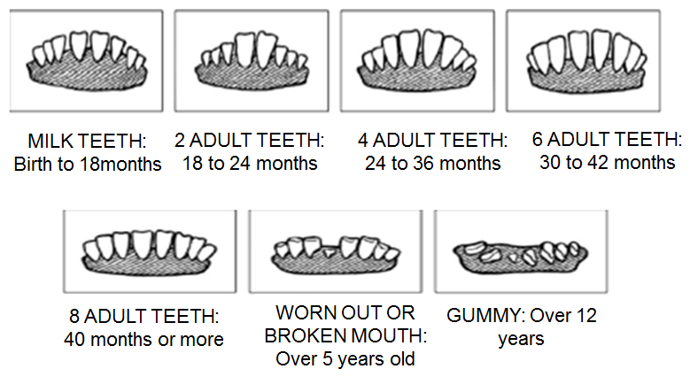
Age Determination by Dentition

Slide 44
Identification
Identification of individual calves should be done immediately it is born.
Ear tags, ear notching, branding commonly used.
Branding usually done between 5 – 6 months or simply after weaning.
Branding can be done using:
Hot branding iron
Cold (Freeze) branding iron

Slide 45
Castration
Bull calves should be no more than 3 or 4 months of age.
There are more problems with bleeding and weight loss when older bulls are castrated.
Three methods are commonly used:
elastrator bands,
use of Burdizzo, and
surgical method.
Bloodless techniques

Slide 46
Dehorning
Horns are usually removed to prevent injury to other cattle and to handlers.
It is best done when calves are under 3 months old as this will not cause no setbacks (normally between 3 – 4 weeks).
Common methods of dehorning include:
Hot iron
Dehorning knife
Scoop or cup dehorners
Hand saw – older cattle
Chemical : Liquid, paste, or caustic potash sticks – calves under 2 weeks

Slide 47
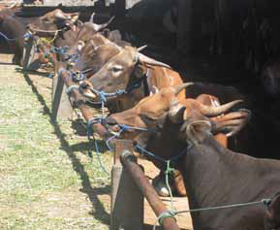
Restraining
If cattle are to be handled individually by the farmer, they will need some system of restraint and control.
Different methods used:
Halter
Bull leader
Nose ropes
Chute or crush
Use of Halter

Slide 48
Record Keeping
Examples of records kept:
Growth or weight records
Health records
Mating records
Calving records
Financial records, etc

Slide 49
Herd Health
The key to the success of the health plan is the prevention of problems.
Being familiar with the diseases and parasites that affect beef cattle can help farmers plan preventive programs that reduce health problems and increase profits.
Observing the vital signs (temperature, pulse rate, and respiration rate) in an animal can help in the early detection of health problems.
temperature (normal range is 38°C to 39.3°C).
pulse rate (normal range is 60 to 70 heartbeats per minute).
respiration rate (normal range is 10 to 30 breaths per minute).

